Slide 1
MKTG 571:
Summary and Wrap-up
A Broad View of CRM

Slide 2
Today’s Agenda
To discuss the results of the Netflix case
To discuss what we have talked about over the course of the semester
To discuss the future of CRM
To discuss the final exam questions

Slide 3

Netflix
Marketing Metrics vs. Financial Metrics
Who are the competitors?
Redbox, Amazon, iTunes, VUDU, etc.
What’s next? DVD sales?
What happened with Qwikster?

Slide 4
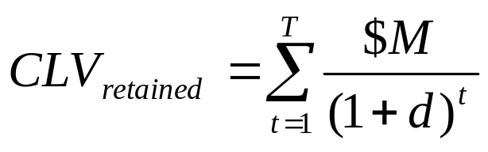
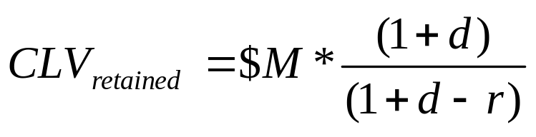
Computing CLV
What is the average value of a retained customer?
M = (Rev – Tech) – (Sub + Fulfil)
d = (1+rate)^(1/4) – 1 = 2.41%
r = (#total_{t} – #new_{t}) / (#total_{t-1})
Turns out we can convert the infinite sum into:

Slide 5
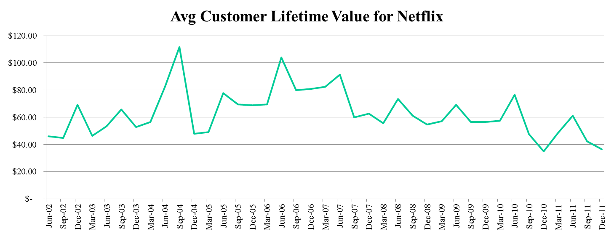
How does CLV vary with time?
Qwikster

Slide 6
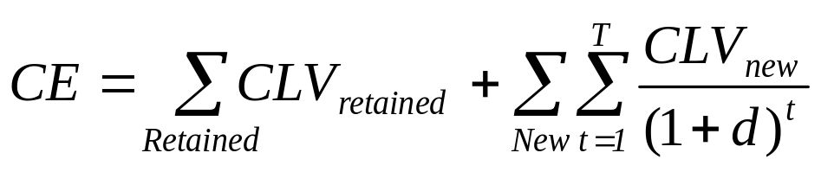
Computing Customer Equity
What is Customer Equity?
Retained = # of retained customers in current time period
New = # of new customers in each future time period

Slide 7
Computing CLV
What is the average value of a retained customer?
M = (Rev – Tech) – (Sub + Fulfil)
d = (1+rate)^(1/4) – 1 = 2.41%
r = (#total_{t} – #new_{t}) / (#total_{t-1})
Turns out we can convert the infinite sum into:

Slide 8
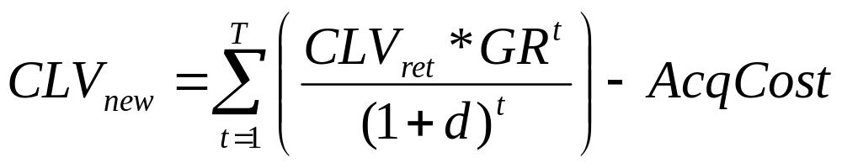
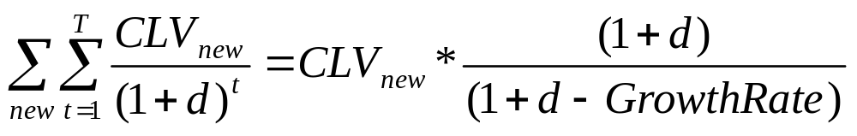
Computing New CLV
What is the average value of a new customer?
M = (GC - Mktg)
d = (discount rate)
GR = (growth rate)
What about all new customers?

Slide 9

Computing Growth Rate
What if we run a regression?
DV = NumNew_{t} | Coefficient (Std. Error) | P-Value
Intercept | 98.764 (97.000) | 0.315
NumNew_{t-1} | 1.011 (0.043) | < 0.0001
R-square = 0.930

Slide 10

CE vs. Market Cap
Are they related?
What if we run a regression?
DV = Market Cap | Coefficient (Std. Error) | P-Value
Intercept | -1,177,121.40 (402,588.40) | 0.006
Customer Equity | 0.442 (0.037) | < 0.0001
R-square = 0.84

Slide 11
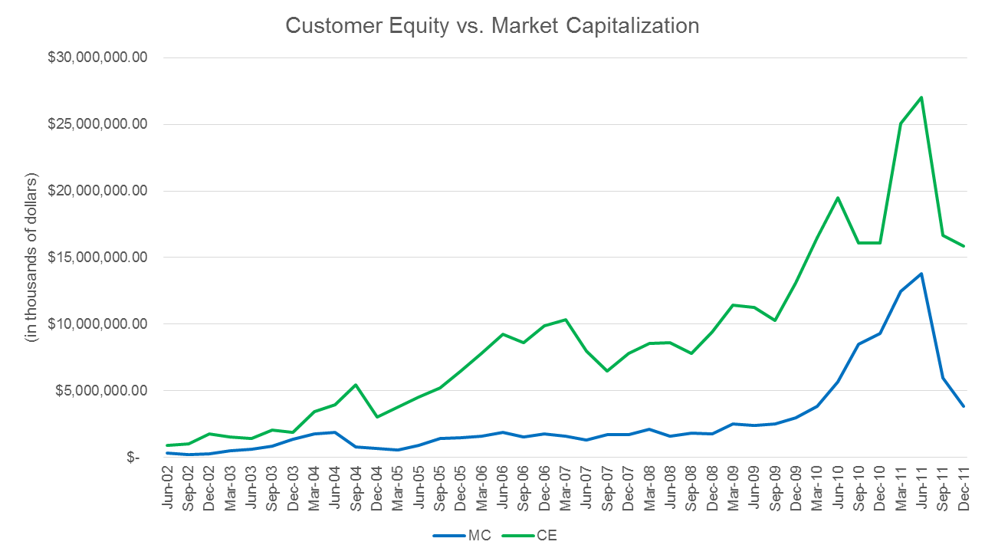
CE vs. Market Cap

Slide 12
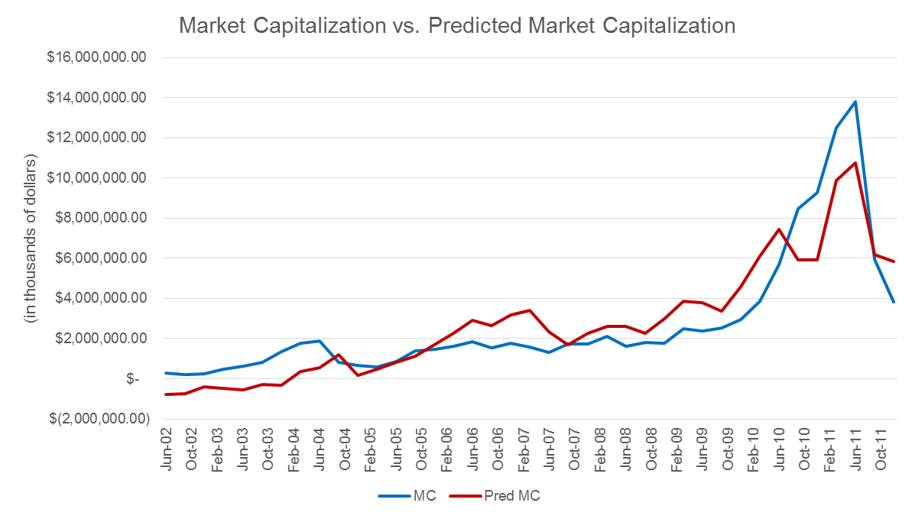
Predicted MC vs. Actual MC

Slide 13
Other Questions
Who is Netflix biggest competitor?
Should Netflix consider selling DVDs?
Why didn’t Qwikster work?

Slide 14
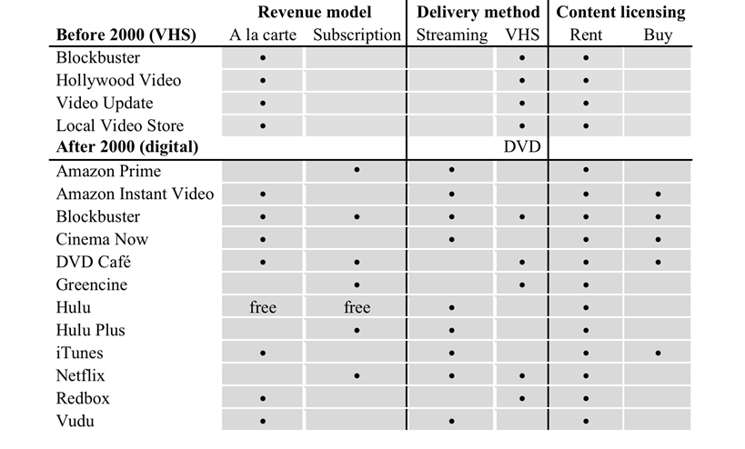
Competitors

Slide 15
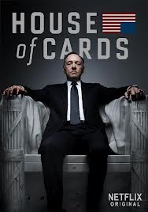
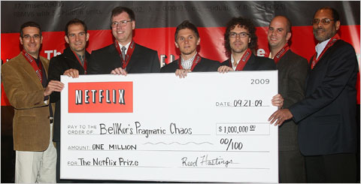
Innovations
Original Content
September 21, 2009, 10:15 AM
Netflix Awards $1 Million Prize and Starts a New Contest
The company’s challenge, begun in October 2006, was both geeky and formidable: come up with a recommendation software that could do a better job accurately predicting the movies customers would like than Netflix’s in-house software, Cinematch. To qualify for the prize, entries had to be at least 10 percent better than Cinematch.

Slide 16
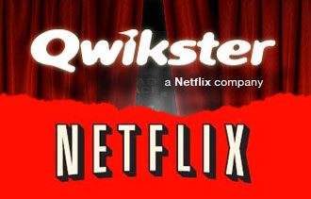
Qwikster?
Why didn’t it work?

Slide 17
Summary/Wrap-up
What did we learn?
Topics
  CRM Strategy/Implementation
  Customer Acquisition & Retention
  Cross-selling and Up-selling
  Customer Profitability and CLV
  Loyalty and Loyalty Programs
  Customer Metrics and their link to Profitability & Shareholder Value
Tools
  Decile Analysis
  RFM Segmentation
  Predictive Modeling
    Logistic regression
    Decision trees

Slide 18
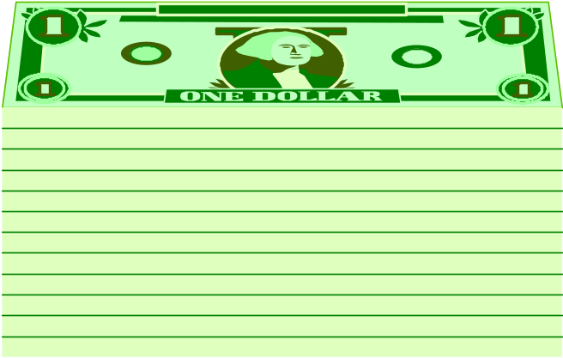
Summary/Wrap-up
Fundamental premise of effective CRM:
The customer is an asset that companies and organizations should measure,
manage and maximize just
like any other asset.

Slide 19
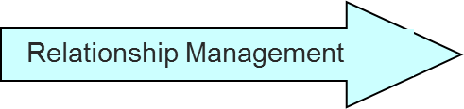
Think ‘birth’ to ‘death’: The Customer Lifecycle
Acquisition
Prospect
Responder
Customer
Former
Customer
High
Value
Voluntary
Churn
Target
Market
New
Customer
High
Potential
Responder
Forced
Churn
Low
Value
Retention
Up-selling
Cross-selling
Personalization
Winback

Slide 20
Guiding Principle of CRM:
Grab, Grow and Hold the Right Customers
$
Better Development
Better Retention
Profit
Loss
Time
Better Acquisition

Slide 21
Summary/Wrap-up
Customer Acquisition
  Identify the customer profile(s) you want and be selective
  Don’t overinvest
Customer Development
  Grow share of customer
  Reduce costs
Customer Retention
  Identify priorities for customer retention
  Monitor ‘lapsed’ customers
Customer Abandonment
  Assess value to identify undesirable customers
Resource allocation
  Should match customer strategy

Slide 22
CRM is not just for profits
Charitable organizations
  Ex: Nature Conservancy, American Heart Association
  DRM? (donor relationship management)
Educational institutions
  Ex: Universities
  ARM? (alumni relationship management)
Arts organizations
  Ex: Symphonies, Museums
  PRM? (patron relationship management)
Community organizations
  Ex: Boy Scouts
  MRM? (member relationship management)
Political Organizations
  Ex: Democratic National Committee, Log Cabin Republicans
  CRM? (constituent relationship management)

Slide 23
CRM: Not “one size fits all”
  -Degree of customer heterogeneity (LTV, cost to serve, risk)
  -Level of interaction (granularity)
  -Directness of contact (channels)
  -Information richness
  -Type and frequency of category purchase
  -Nature of product (customizability, hedonic vs. utilitarian attributes)
  -Top management orientation
  -Integration of organizational processes
  -Technology alignment and information capture
  -Implementation
    Analytical, Operational
  -Customer behavior
  -Customer attitude
  -Learning about the customer
  -Profitability
  -Product and service adjustment
Industry
factors
Organizational
factors
CRM
Performance

Slide 24

Challenge I:
Marketing Analytics
Data mining and predictive modeling promise to grow the top line through cross-selling, etc. and reduce costs through efficiencies
But – are we strip-mining customers rather than treating them as a renewable resource?
Challenge:
  Short-term vs. long-term
  perspective

Slide 25
Challenge II:
Data, Privacy and Consumer Trust
Individual-level data is the fuel for CRM
  Traditional sources augmented by new sources including online behavior, RFID, etc.
Customer Trust is key
Analytics is the ‘engine’
We are the drivers

Slide 26

Challenge III:
The “Soft Side” of CRM
Must blend science and analysis with psychology
Drivers of Satisfaction and Loyalty
Incentives and Rewards
  Utilitarian vs. Hedonic
  Aspirational elements

Slide 27
Final Exam
Assignment:
  Retail Relay
  Due: April 28th by 5pm (earlier is fine)
  Email it to me at jap@psu.edu
  Rule: Open-books, open-notes, closed people

